Slide 1

GNU/Linux User Group
2024-01-31

Slide 2
Admin stuff
Website: http://lug.acm.illinois.edu/
GitHub: https://github.com/gnulug

Slide 3
Communication
Discord server / Matrix room
> Main channel / room
Discord rooms are bridged to Matrix
Default Matrix client: app.element.io

Slide 4
Weekly meetings
Schedule can be found at: github.com/gnulug/meetings
> Look for 2024s/SP24 schedule.md
Every Wednesday 6pm - 7pm at Everitt 3217

Slide 5
What do we usually talk about?
Usually will cover some news at the start
Linux things - Shells, Text editors, distros etc
Personal projects
Specific OS/system topics
  containers, filesystems etc

Slide 6
GLUG/Infra cluster
Once upon a time, there was servers in Siebel 3103
Servers belonged to ACM
https://github.com/sigglug-illinois/acm-glug-cloud
Goal (for now): Generic container hosting
Talk to them to find out more / ask questions
  Nathan (pngdeity)
  Jenna

Slide 7
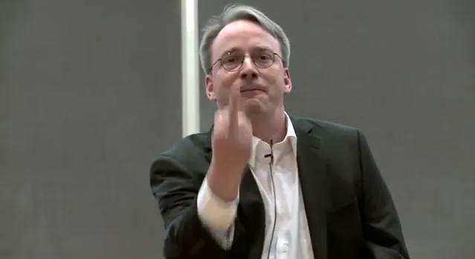
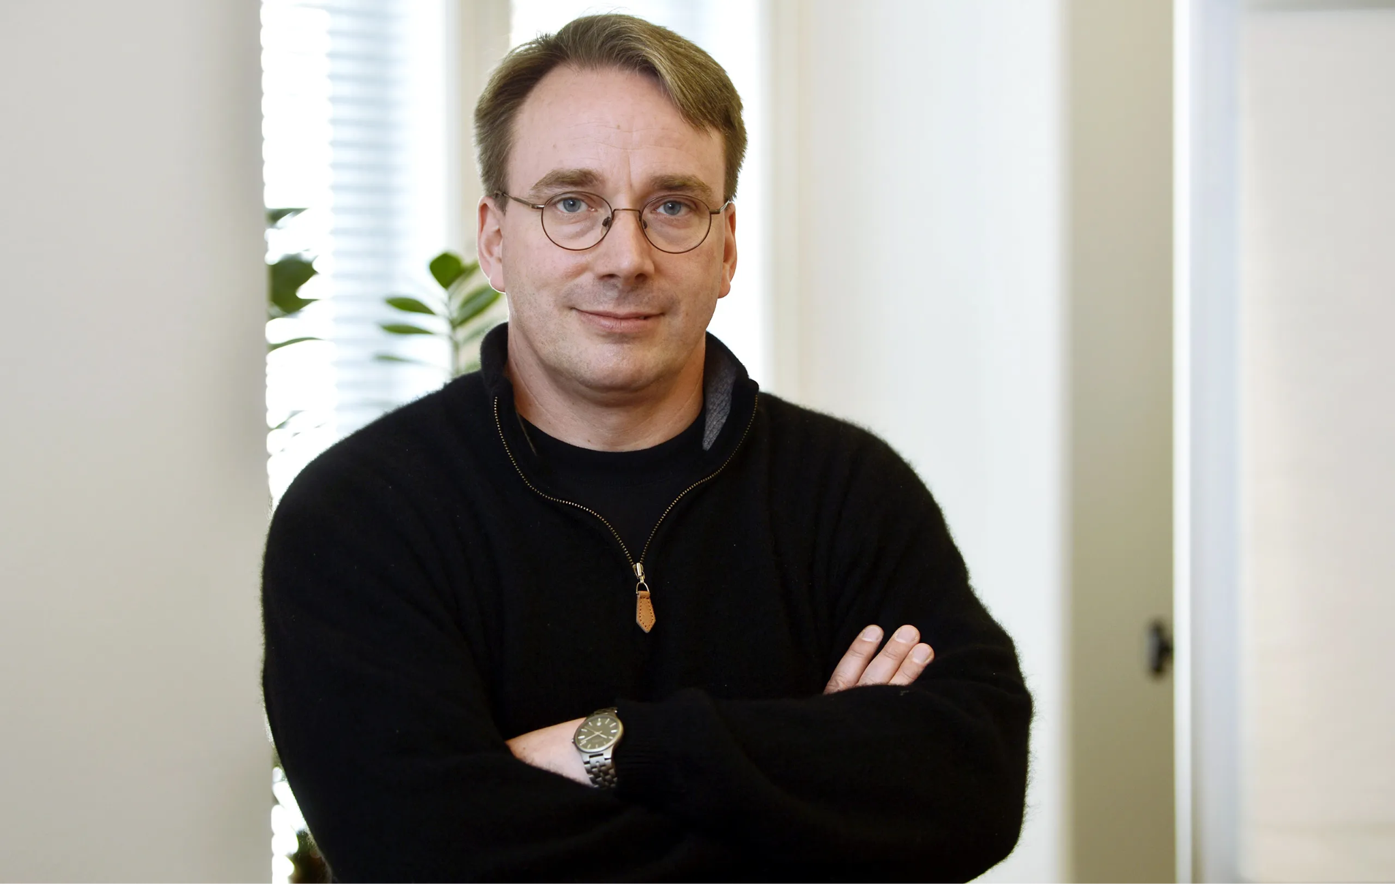
What is Linux?
Operating system kernel
Made by Linus Torvalds ↓ and released in 1991

Slide 8
What is GNU?
GNU Project writes a lot of free software
gcc, libc, coreutils

Slide 9
What is a Linux distro?
Distro is short for distribution
Common ones you’ve probably heard of: Ubuntu, Arch Linux, Fedora
Community developed vs Commercial
Rolling releases vs Point releases
Repos and package manager
https://upload.wikimedia.org/wikipedia/commons/1/1b/Linux_Distribution_Timeline.svg

